Slide 1
Optimus Octavian
Volvo CoPilot Safe Assist
November 13, 2017

Slide 2
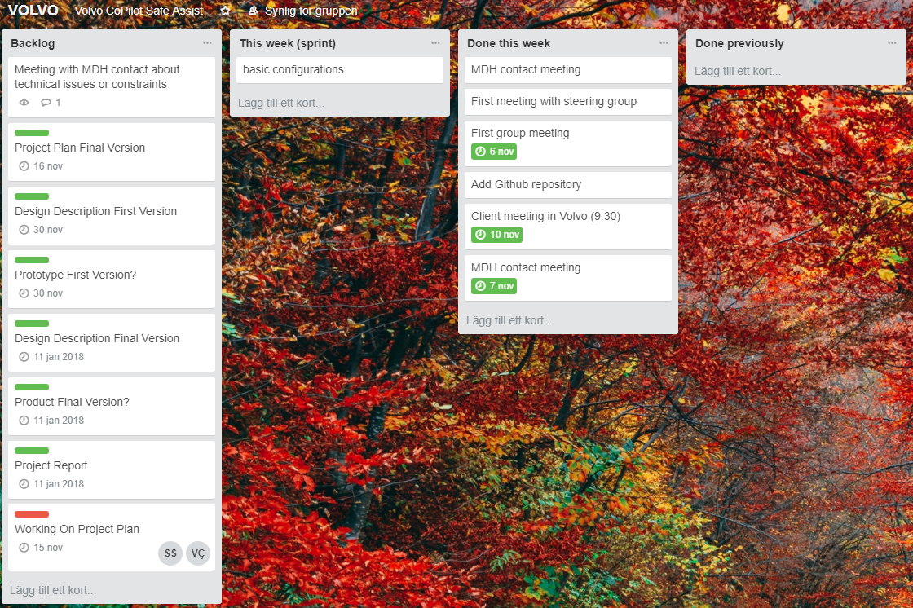
Previous week

Slide 3
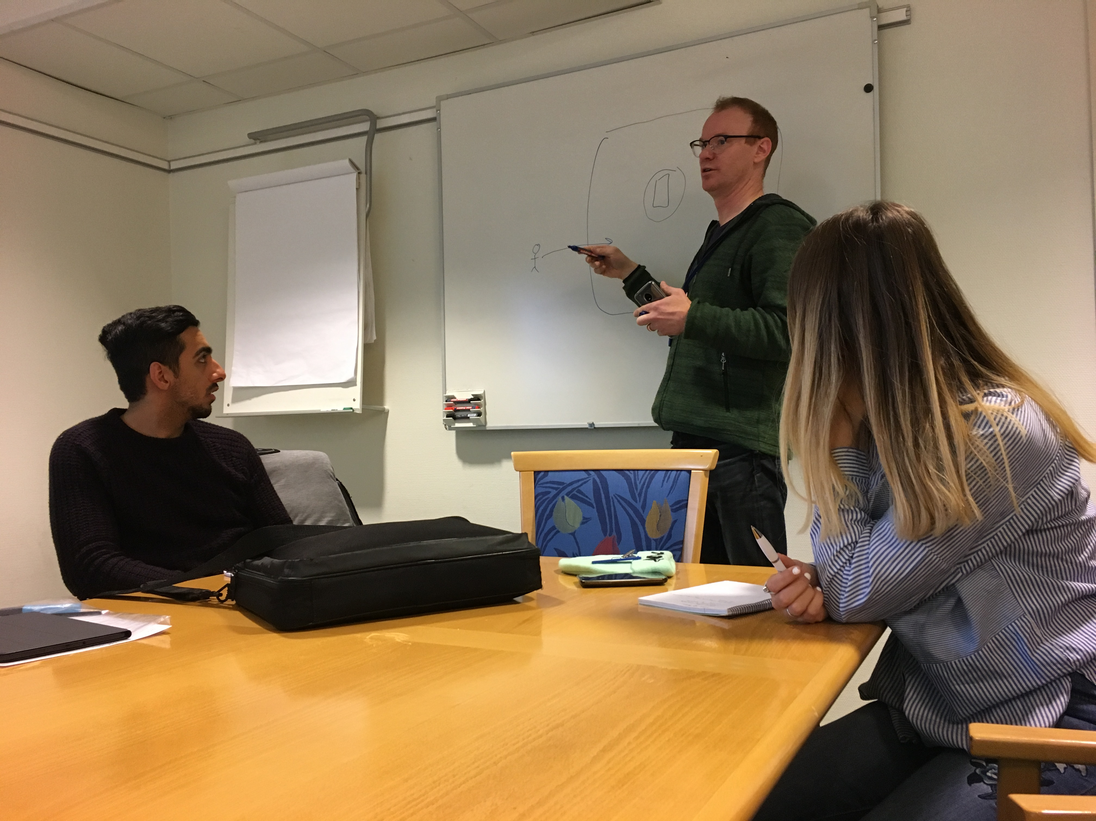
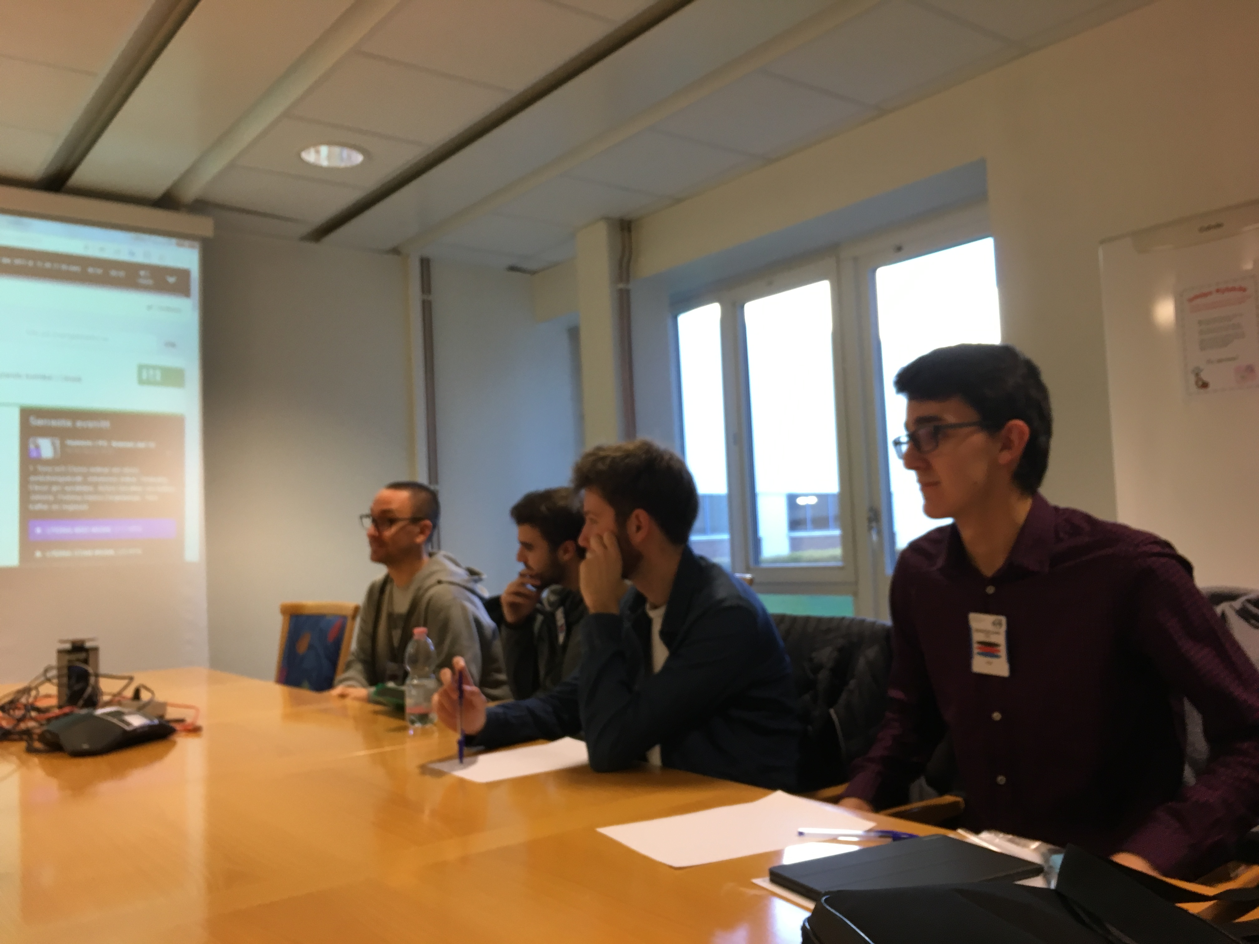
Meeting with client
Introduction and tour of the site.
Risks and safety on working sites.
Requirements overview.
No precise specification.
Work in a agile manner.
Keep a dialogue.
Wanted us to find solutions and come up with ideas.

Slide 4
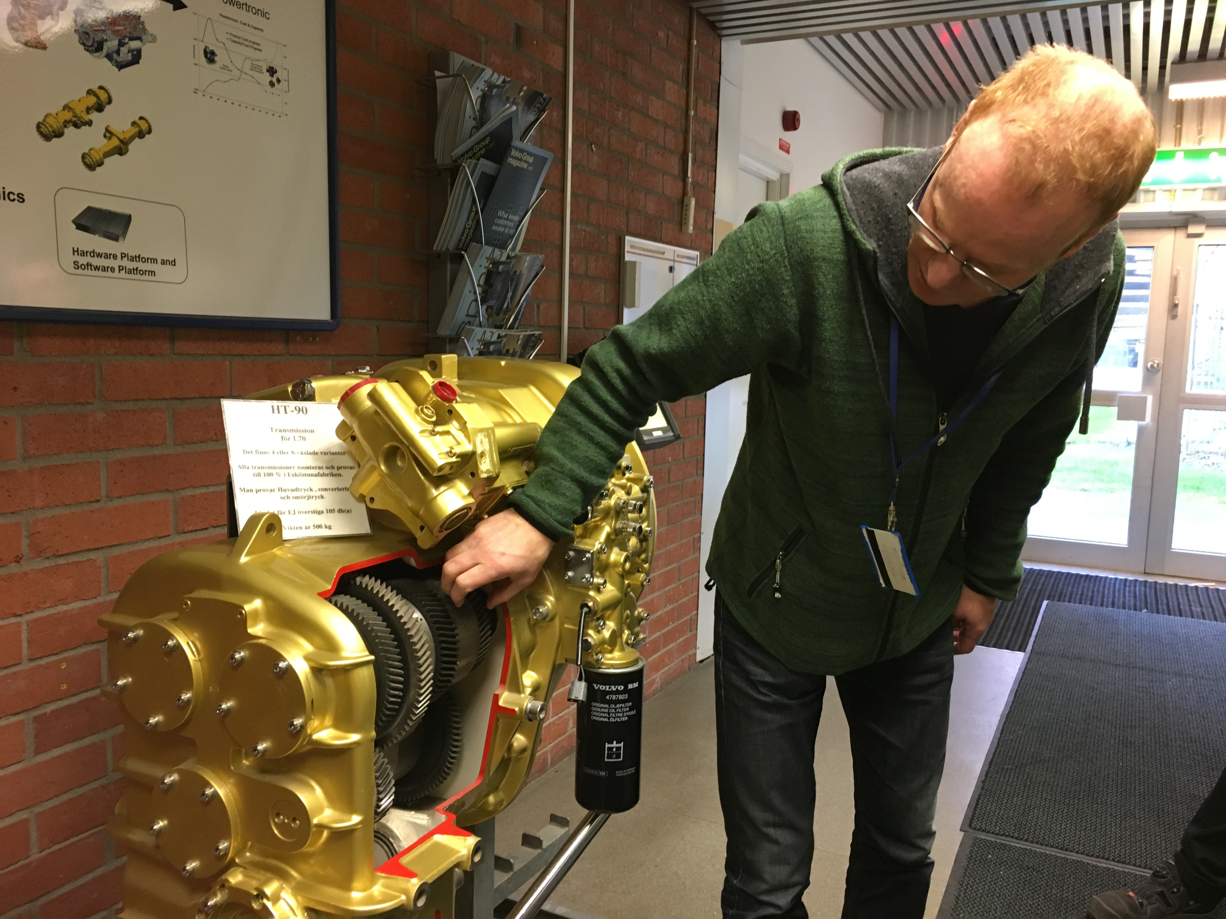
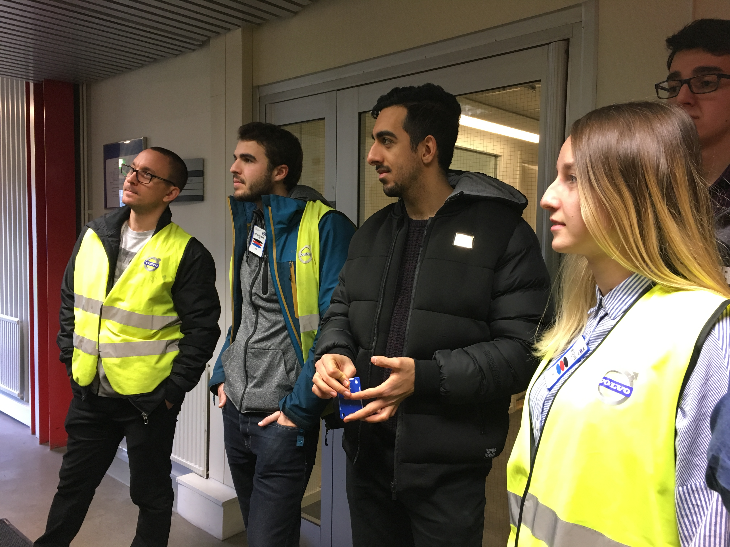
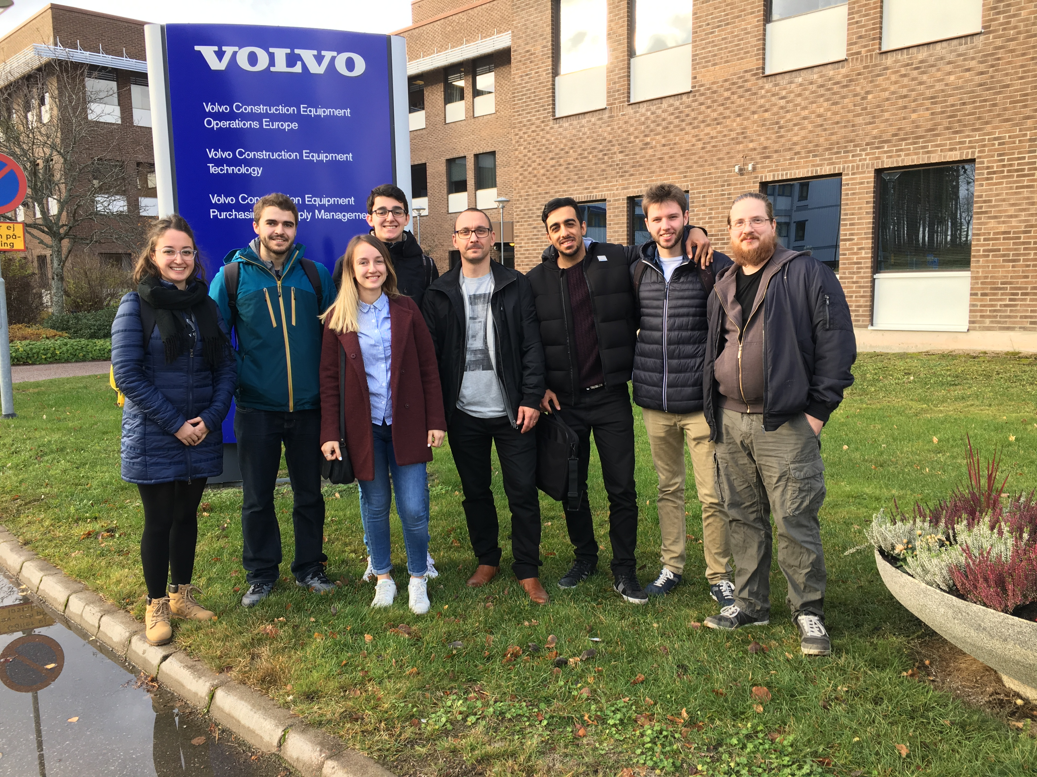
Meeting with client

Slide 5
Worked Hours
15 hours per person (not counting minor tasks)
Question:
How detailed should the hour declaration be?

Slide 6
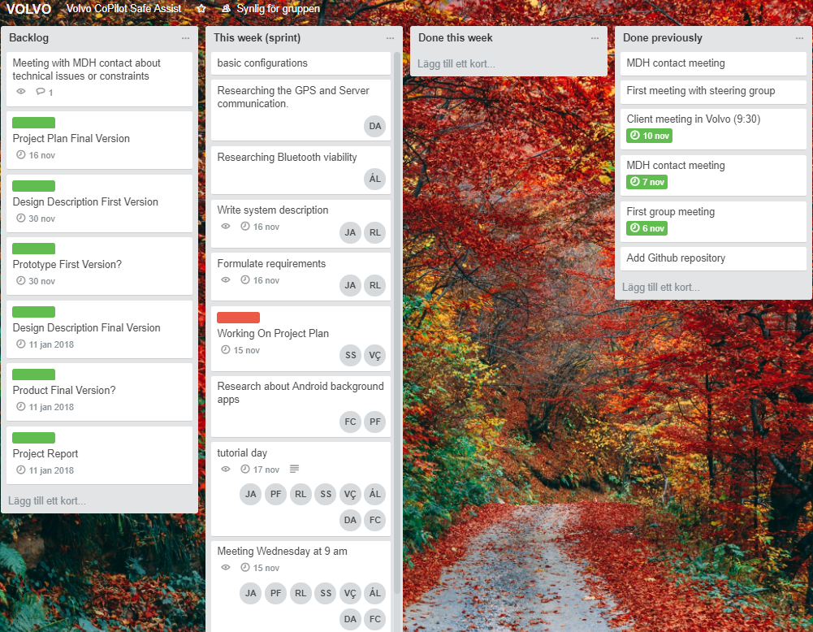
Next Week

